Slide 1

U.S. & California
COVID-19
Jaclyn Coate
Josh Eysenbach
Project: EDA
Summer 2020 Time Series 6373
Notes:
I’m Jaclyn Coate. Josh Eysenbach and I are here to present a quick overview of our initial COVID analysis for the US and California.

Slide 2

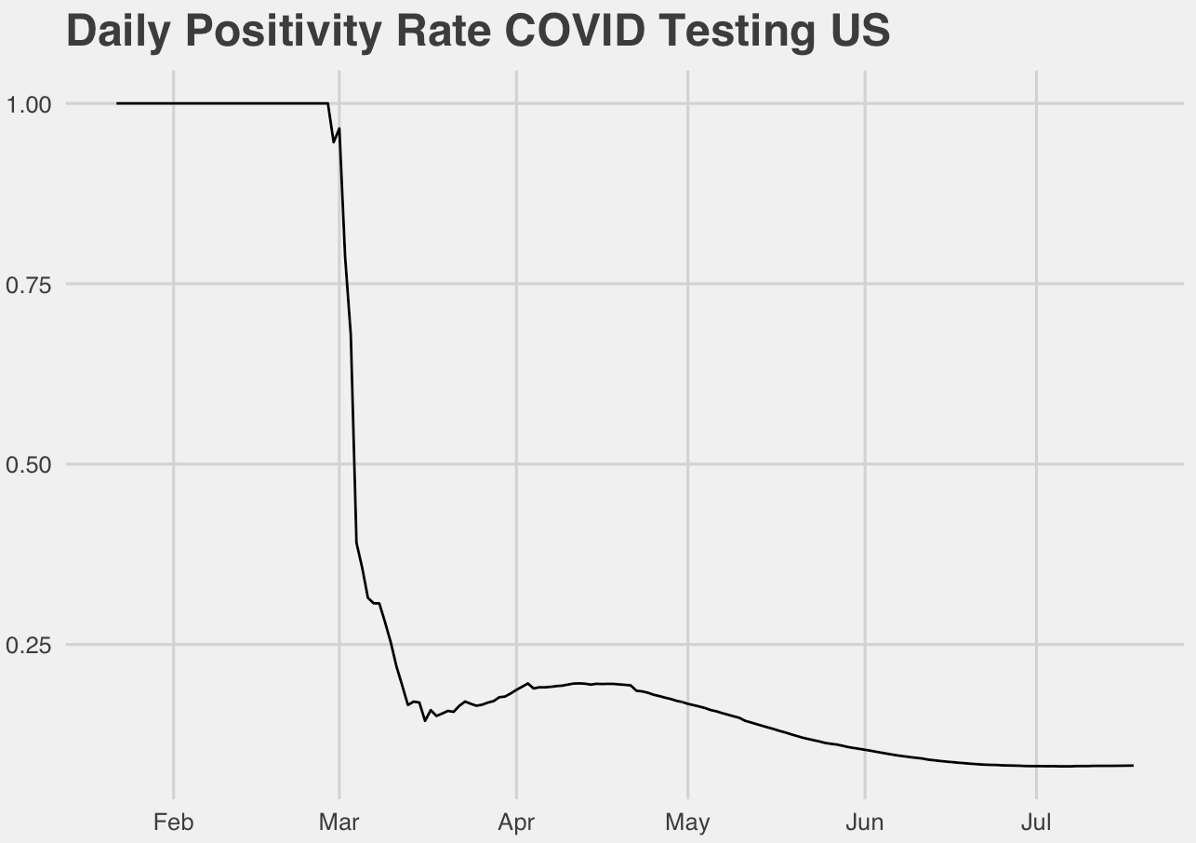
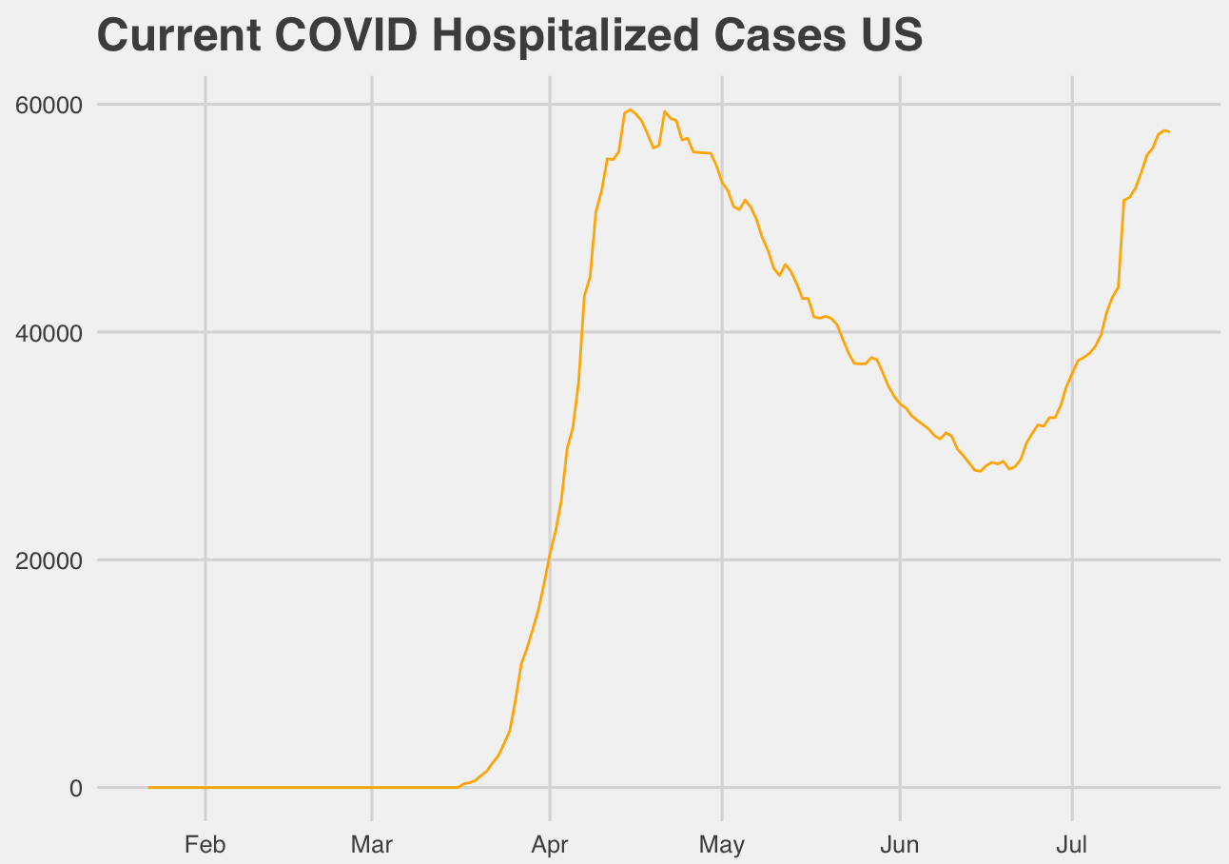
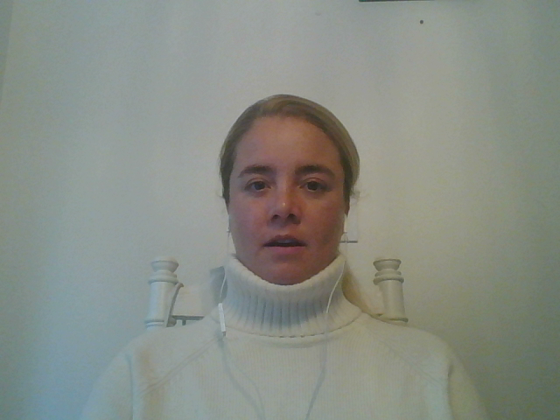
Overview
Presenters
Josh Eysenbach
Jaclyn Coate
Data Set
The COVID Tracking Project
California data: ca.gov
Severity Measurement
Positive Percent
Death Rate
Currently Hospitalized
Notes:
We have spent the last week reviewing data sets to build useful models for prediction of COVID severity. Our data set used is The COVID Tracking Project, it is built from official state and federal data collections, as well as used by many trusted groups such as the CDC and Johns Hopkins. We believe this is the best data source at this time.
Josh 30 sec
Positive percent is a stat appearing more recently that normalizes the growing number of COVID cases by dividing them by the total number of tests, but we wanted to choose a variable that best represents what we should use to make decisions. Studies have shown anywhere from 40-80% of people are asymptomatic. We think the count of Hospitalized COVID patients is a better representation of the current impact on the community if we assume the amount of testing is independent of people showing symptoms. After all, the original driving force to “flatten the curve” was out of concern that our hospitals would be overrun, so it makes sense to use this to model the problem.

Slide 3
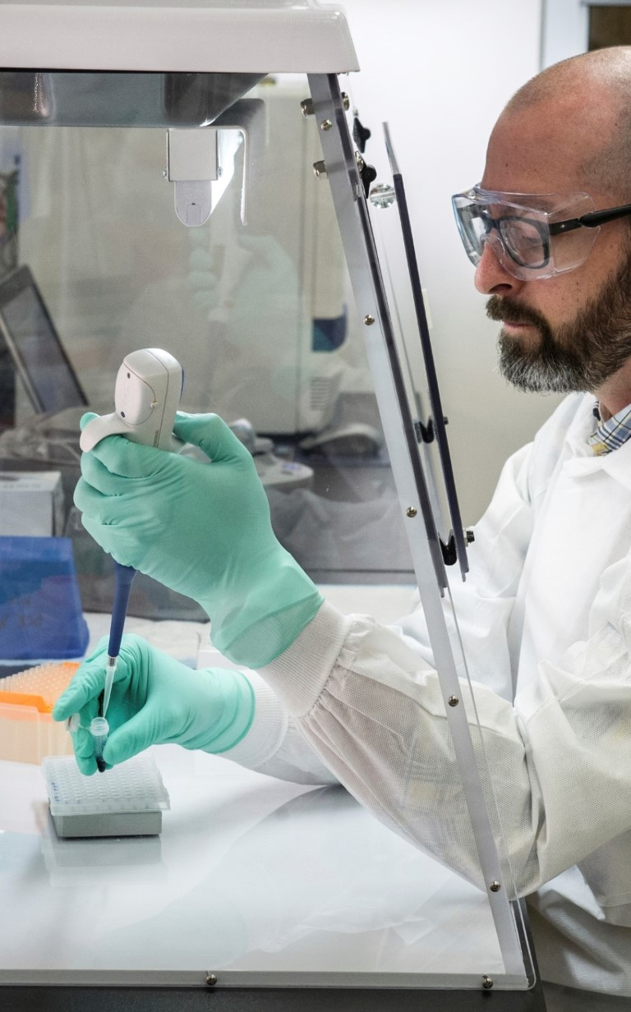
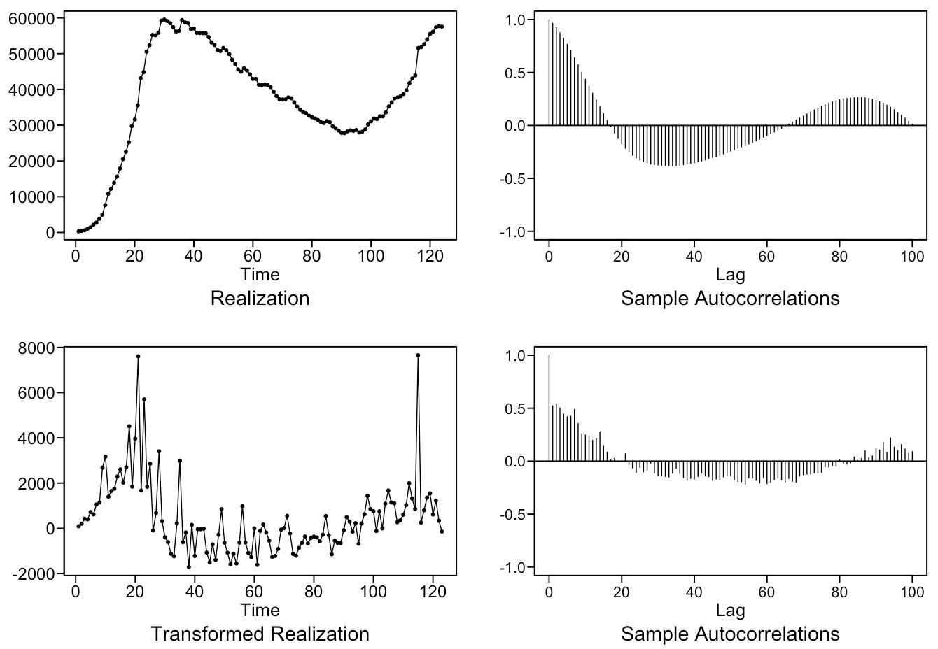
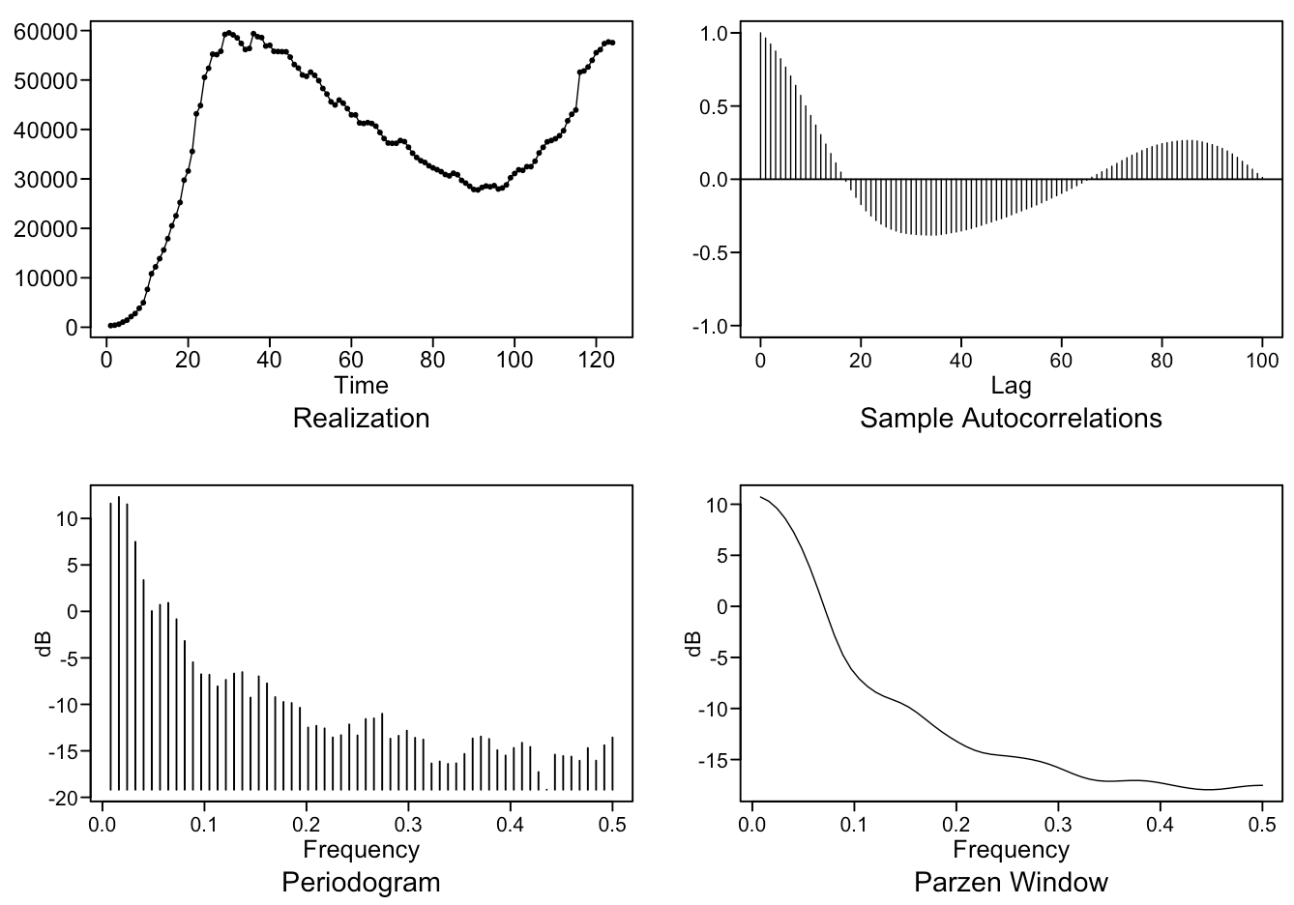
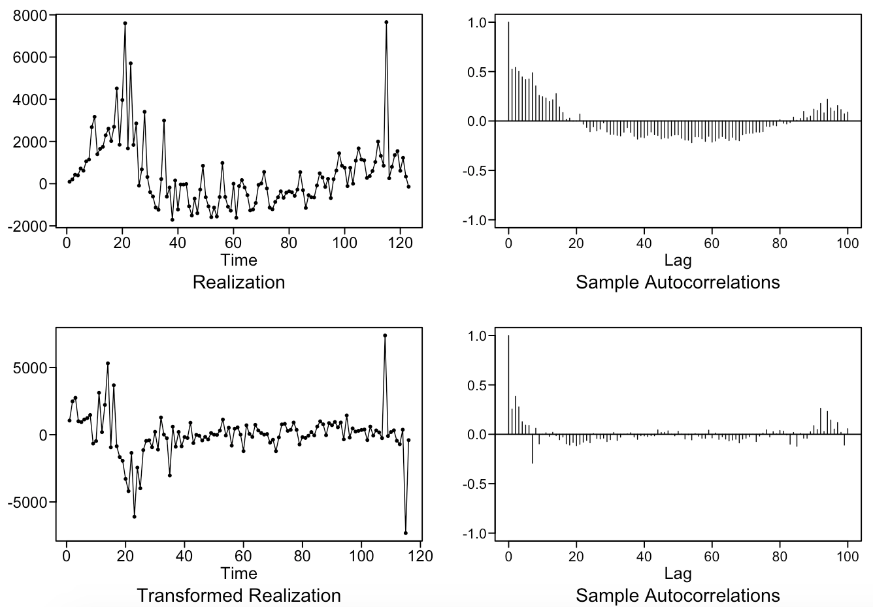
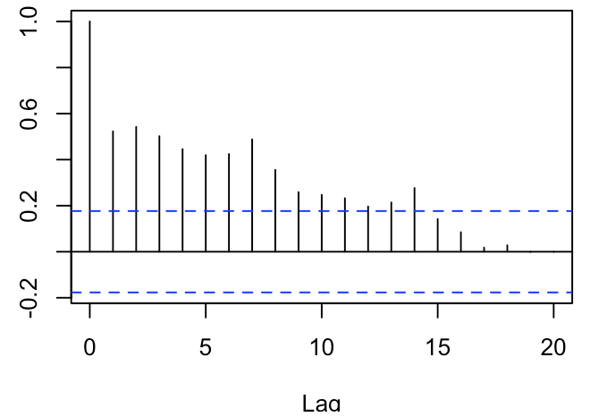
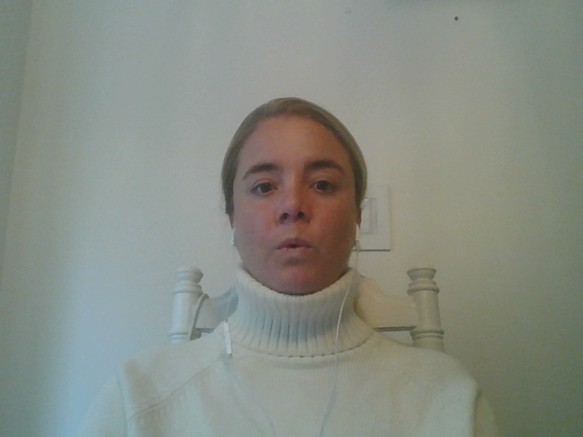
United States
Stationary v Non-stationary
Realization
heavy wandering
ACF
slowly damping
pos and neg correlation ?
Spectral Densities
frequency = 0
slight wave feature
Difference and Transformation
Notes:
We’ll examine the US data first:
**We are working under the assumption COVID is a novel virus and cases, as well as hospitalizations, will return to zero. This assumption means we are working with non-stationary data.
When reviewing the initial data, we see heavy wandering patterns and small pseudo-cyclic behavior in our realization.
The ACF shows slowly dampening behavior consistent with a d=1 ARIMA model.
It also shows highly correlated data, we know it can’t maintain that correlation due to the nature of a novel virus.
The spectral density has a peak at f=0.
As well as a small wave through the rest of the graph line.
This could be a seasonality or frequency component hidden by the heavy wandering behavior in the realization above.
**Single Difference of Data: 12 seconds
We performed a single data difference and now observe what looks much closer to a stationary data set. However, we surfaced a seasonality component, specifically we see the ACF having peaks at 7 and 14.
**Seasonal Transformation of 7 days: 11 seconds
We performed a seasonality transformation of 7 and see that the finale realization has a strong stationary appearance. As well as an ACF that is reflective of data we can model, that is not white noise.

Slide 4

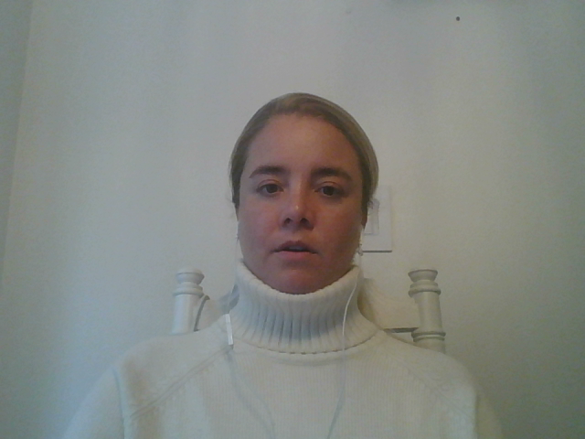
United states
ARMA Candidate Models
ARMA(5, 1)
AIC: 14.5898
AR(2)
AIC: 14.6598
Model Equations
ARIMA(5,1,1), s = 7
(1+.6073B-.5494B²-.5896B³-.0396B⁴+.3023B⁵)(1-B⁷)(1-B)(X_{t}+37955.28)= a_{t}
ARIMA(2,1,0), s = 7
(1-.1531B-.4183B²)(1-B⁷)(1-B)(X_{t}+37955.28)= a_{t}
Notes:
We diagnosed our stationary data and were able to determine an ARMA(5,1) and AR(2) were the best models. With their AICs nearly identical we tested these two models against each other using a windowed ASEs for the short and long term forecasts.

Slide 5

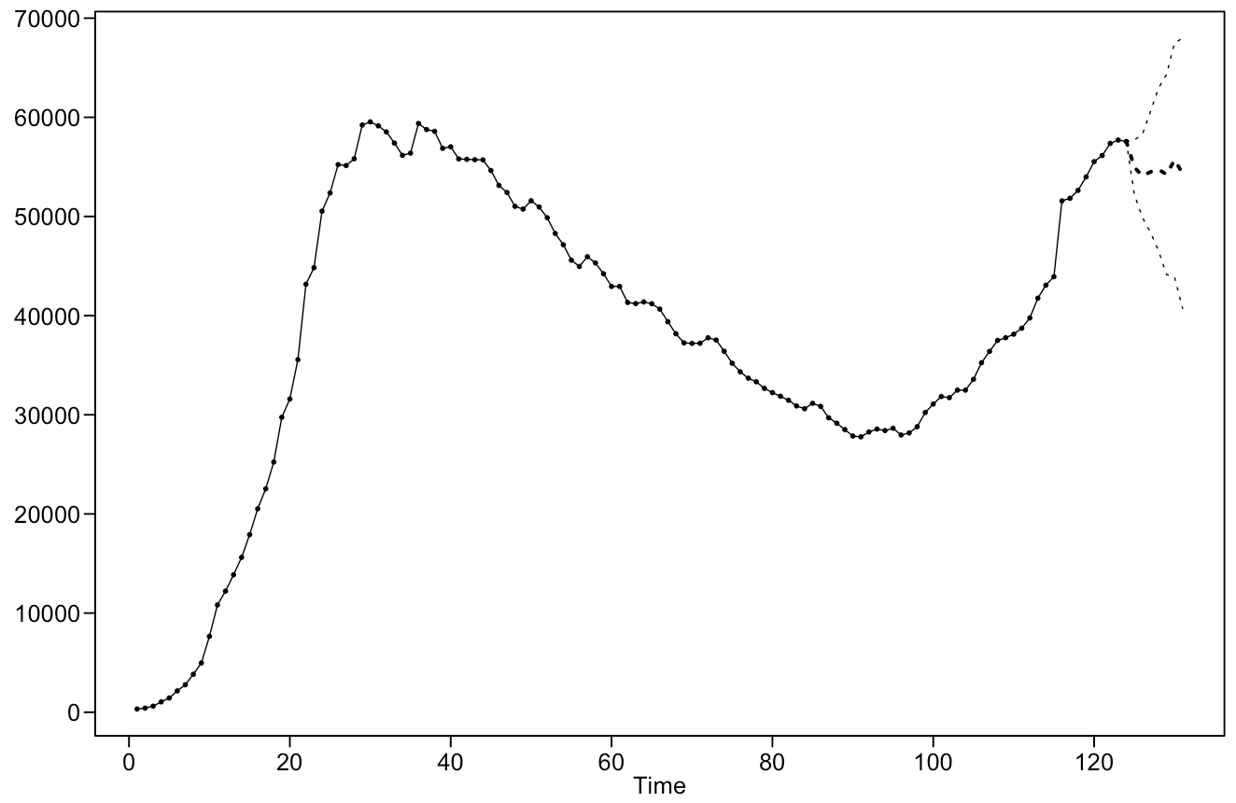
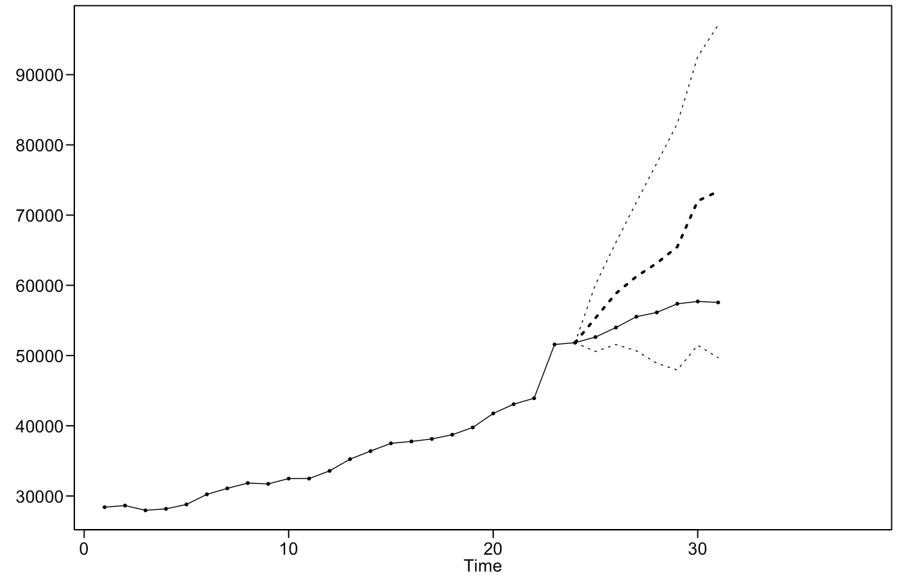
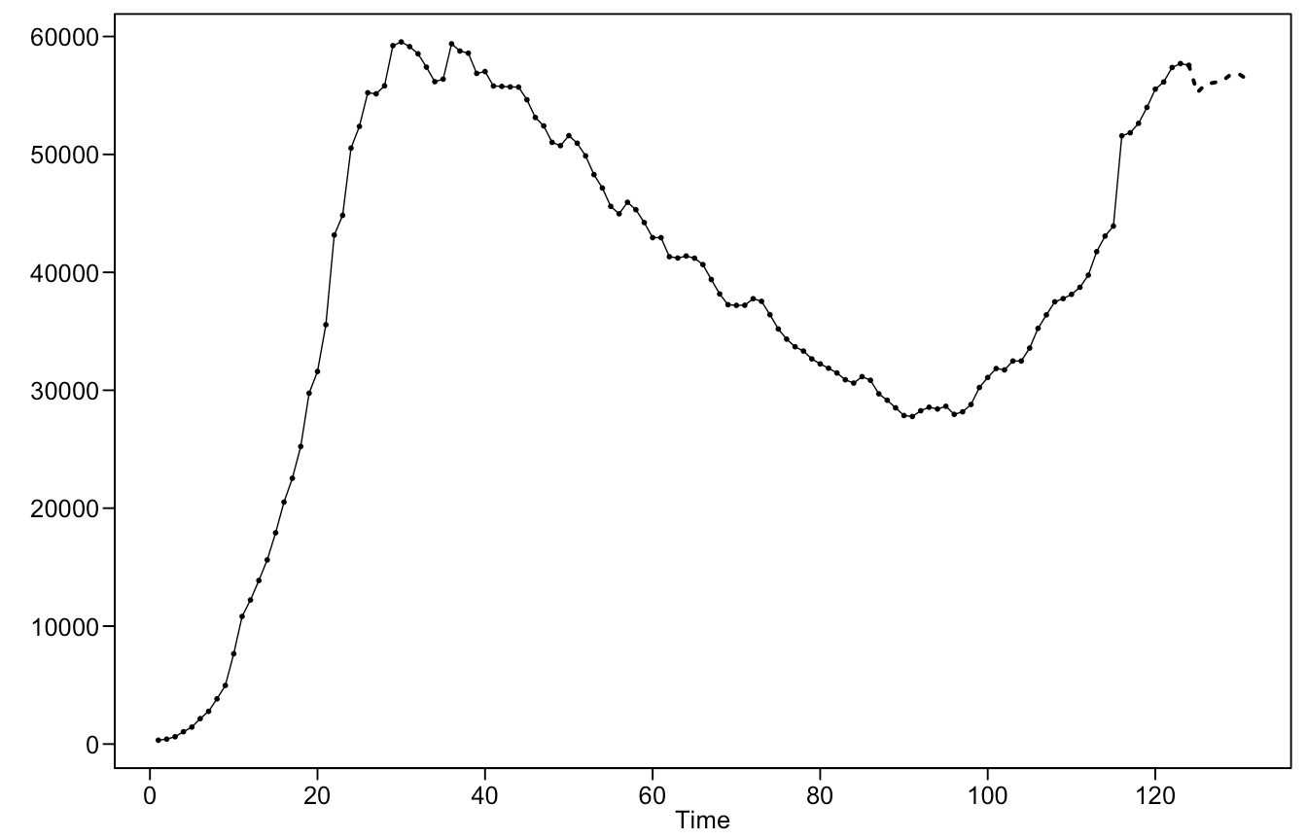
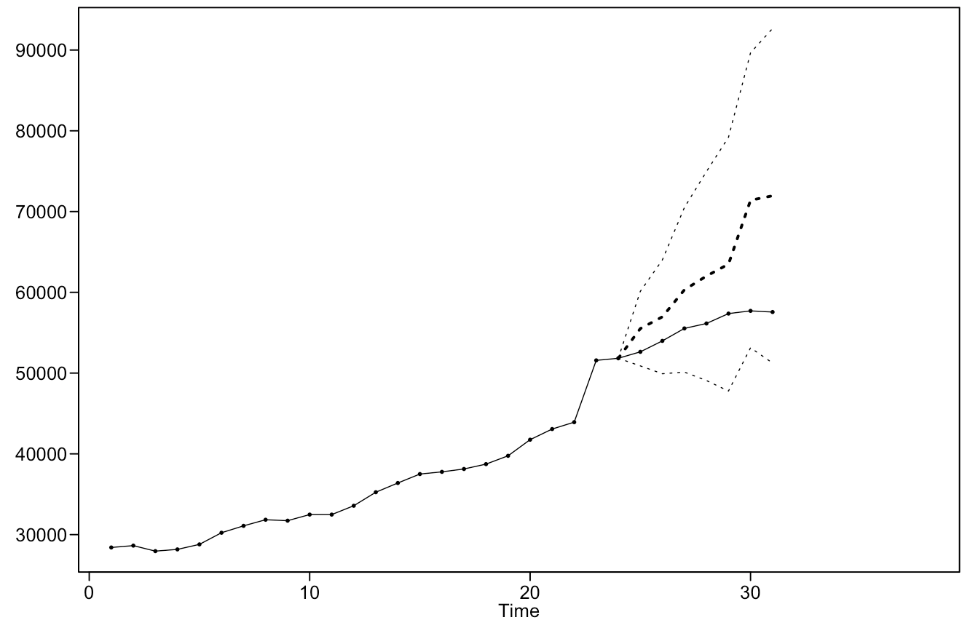
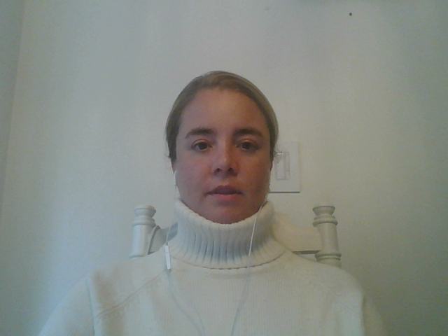
United states
7 Day Forecast
ARIMA(5, 1, 1), s = 7
Windowed ASE: 262,139,992
ARIMA(2, 1, 0), s = 7
Windowed ASE: 303,009,042
Notes:
7 Day Forecast:
The 7 day forecasts for both models continue the trend with a small 7 day seasonality pattern.
The ARIMA(5,1,1) model is a more adequate model with a smaller windowed ASE.

Slide 6

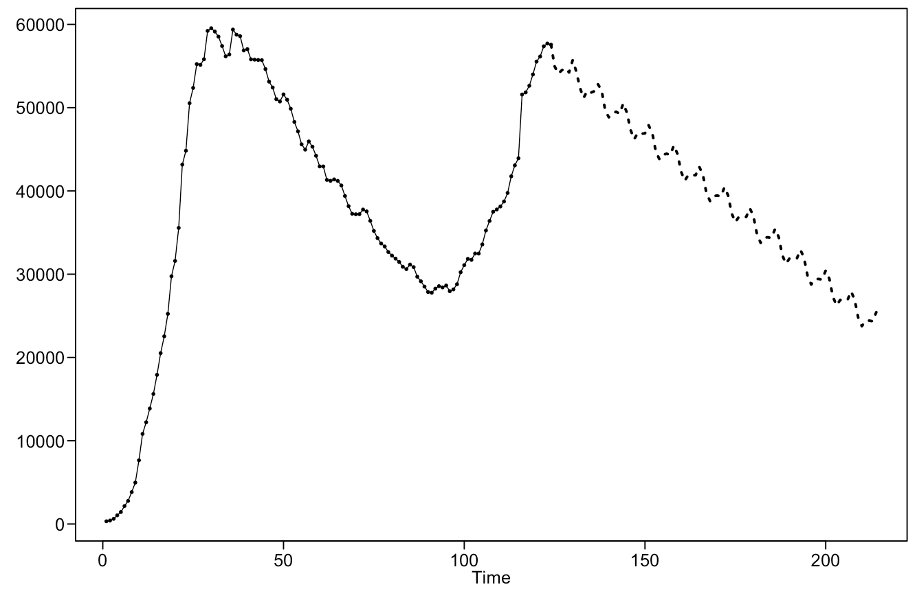
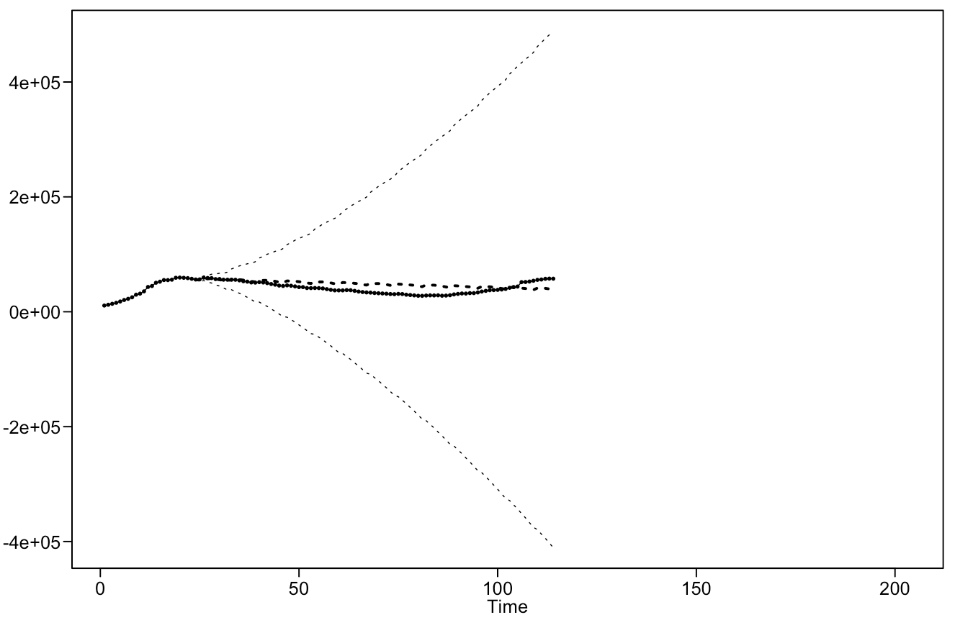
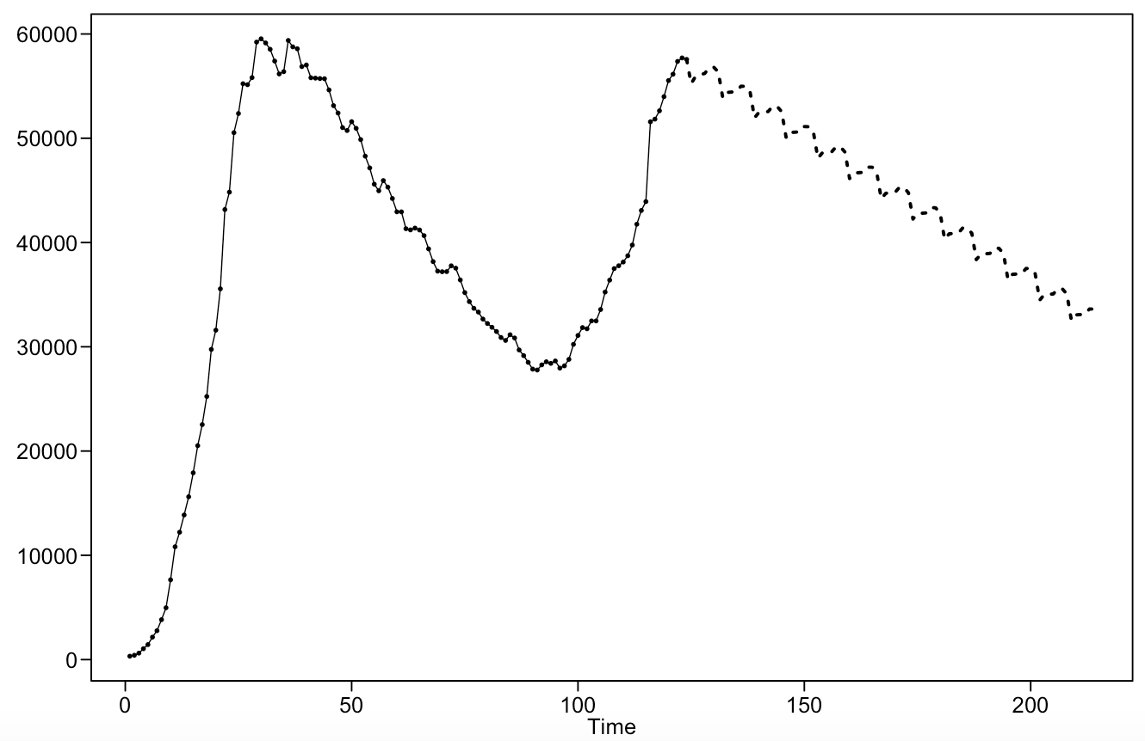
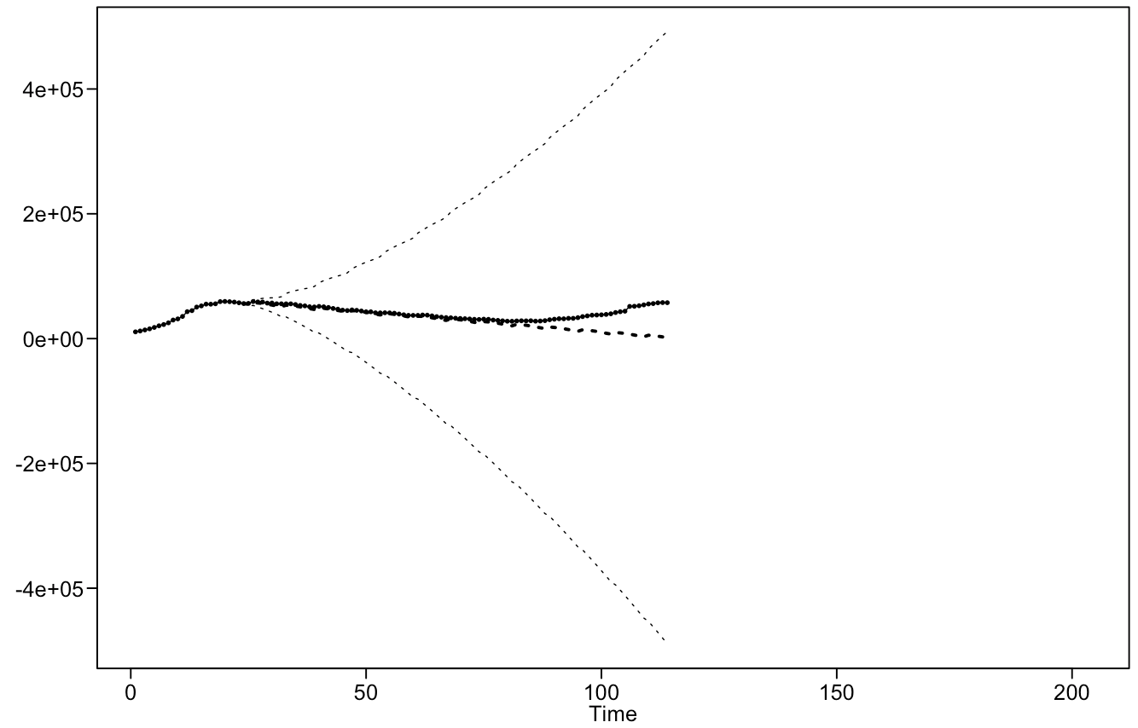
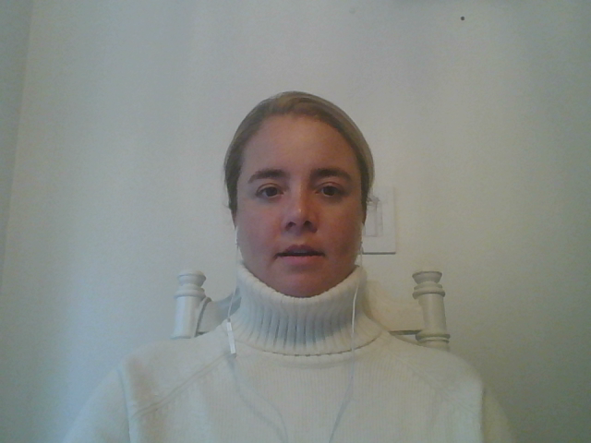
United states
90 Day Forecast
ARIMA(5, 1, 1), s = 7
Windowed ASE: 71,208,194
ARIMA(2, 1, 0), s = 7
Windowed ASE: 71,620,130
Notes:
90 Day Forecast:
Again, the 90 day forecasts for both models continue the trend with a small 7 day seasonality pattern.
And again, the ARIMA(5,1,1) model is proven more useful based on its smaller windowed ASE.

Slide 7

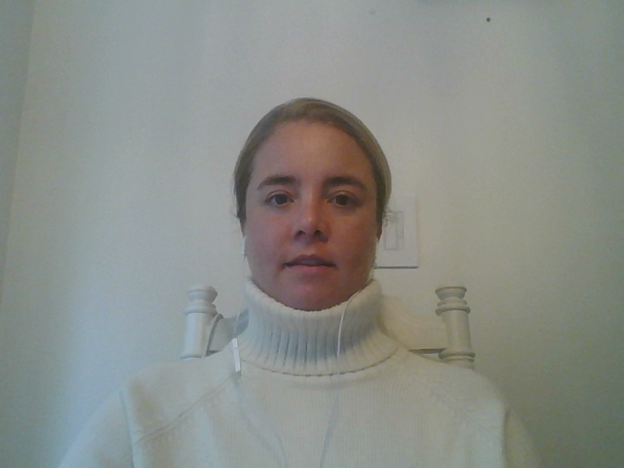
Complete codebooks can be found on our Github.
#covid19
Notes:
Jaclyn
Thank you for taking the time to review our EDA with us today.

